Slide 1

Intro To Programming - Getting Started with Python
DR. HAREEM NISAR

Slide 2
Housekeeping!
Goal : Understand and be comfortable around programming
Classroom environment
No questions are bad questions.
Embracing our strengths and weakness!
Ways to Participate:
Zoom chat
Raise hand button
Unmute and speak (when questions are asked)
Notes:
Encouraged to openly discuss ideas and respectfully listen and consider each other.
Good ideas come from collaboration and open discussions. No one is perfect -

Slide 3
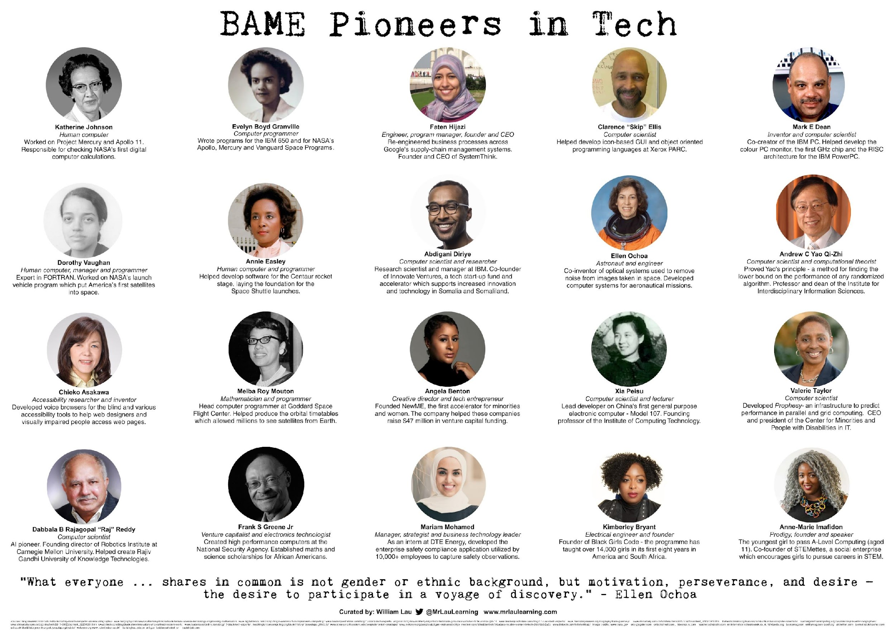
Notes:
1 min total
BIPOC - https://www.youtube.com/channel/UCkpIESktEvOxDXWSMwVWUZg

Slide 4
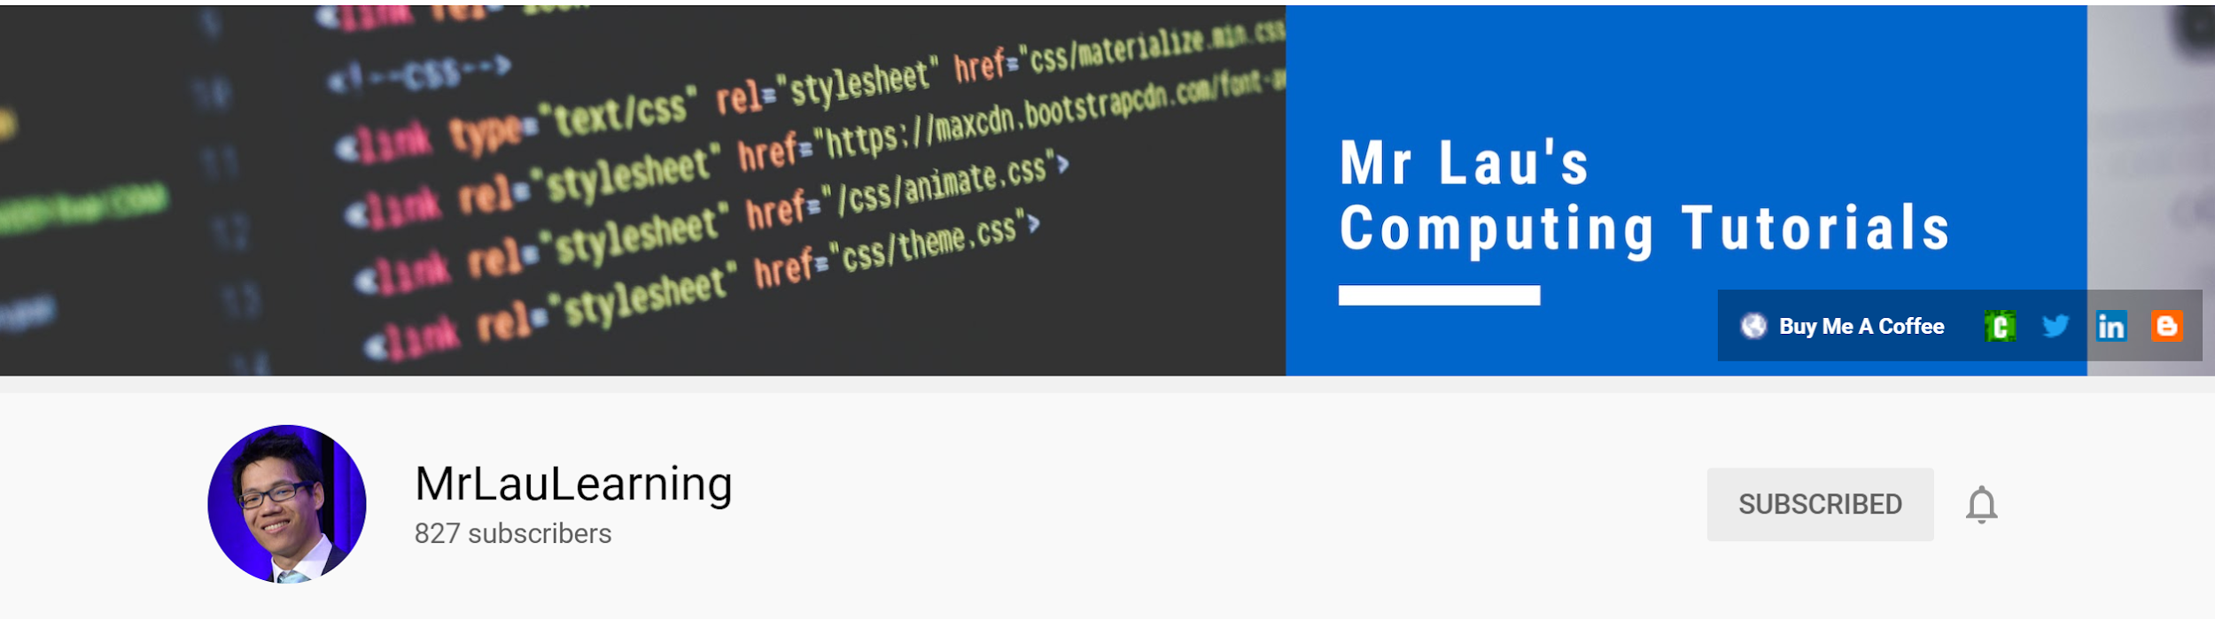
Notes:
Credit where credit is due.

Slide 5
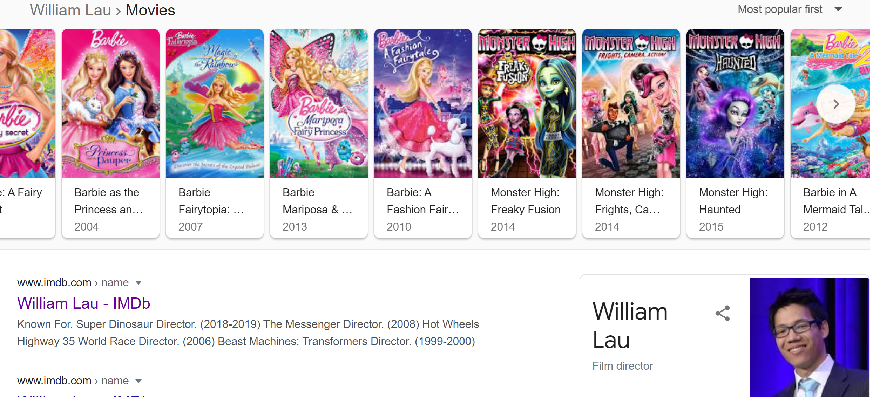
Notes:
Credit where credit is due.

Slide 6
Learning Objectives
Develop ease and comfort around the topic of programming.
1. Learn the basic terminology and structure in programming.
2. Get familiar with coding platform.
3. Develop basic coding skills to be able to read, understand and develop a simple program.
Print
Maths
Variables
String
Notes:
https://answergarden.ch/2214334

Slide 7
Programming Basics & Terminology
LEARNING THE ABC

Slide 8
Terminology
Programming:
the process or skill of writing programs for computers
Program:
A set of instructions, executed sequentially, to perform a task.
Coding:
Act of writing a code
Code:
Written form of set of instructions, written using the protocols of a particular language, such as Java, C or Python
Notes:
A computer Program is an organized collection of instructions, which when executed, perform a specific task or function.
Example: Browser or alarm app or Microft word or paint.

Slide 9
Terminology
Hardware:
Refers to physical equipment: keyboard, mouse, display, button etc.
Software:
Aka computer programs (that performs a task)
Computer System:
Any combination of hardware of software!
Interface:
Medium between different components of a system.
Brain-computer interface (BCI)
Notes:
OPT: software example: operating system is a software that provides a convenient and efficient interface between the user and the hardware
Interface example:
BCI: psychological aspect!

Slide 10
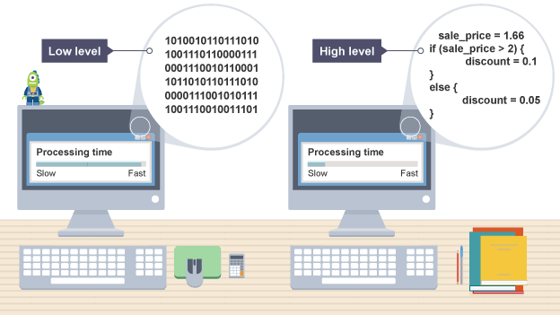
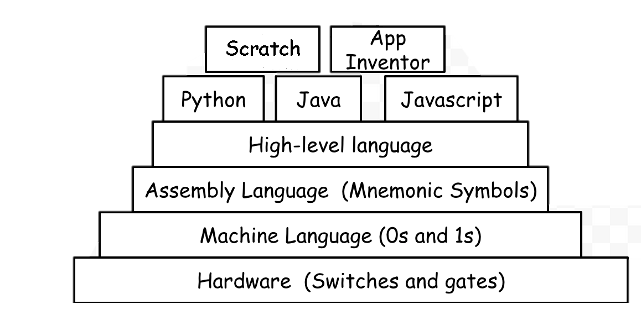
Programming Languages
Human Readability
COMPILER
Machine readability
Notes:
Say High level languages are like English.
Low level languages are like Old English or maybe Sanskrit or Latin perhaps.
Tradeoff b/w time and human readablility.
POLL ?? Why 1s and 0s?

Slide 11
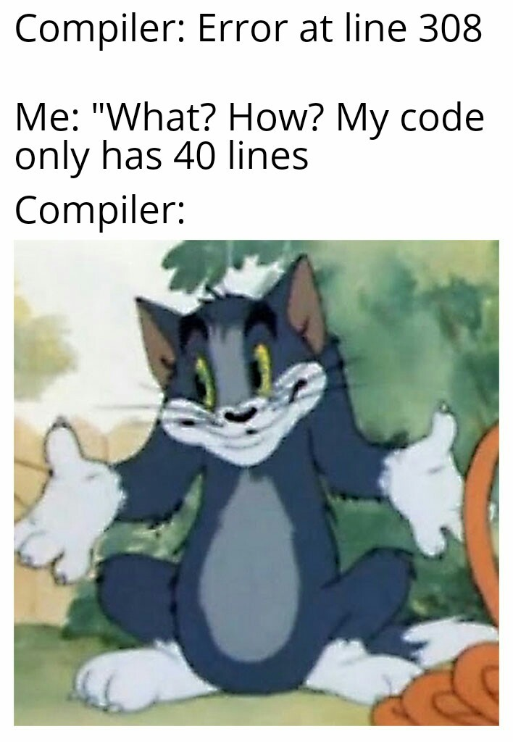
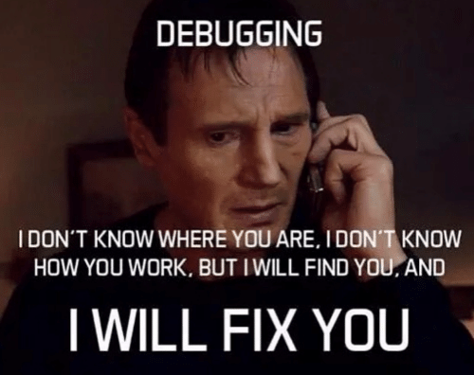
Terminology
Compiler
Converts a high-level language to a machine-readable format
Syntax
the grammar of programming languages
Language specific
Bug – error in the code
Debugging – process of finding and fixing the bug
Syntax error
Logic error
Run-time errors
Notes:
Syntax or compilation errors. Draw out some syntax examples!
Funfact- Grace Hopper in the 1940s coined the term. While she was working on a Mark II computer at Harvard University, her associates discovered a moth stuck in a relay and thereby impeding operation.
Logic error: when the system doesn’t behave as expected/wanted.

Slide 12
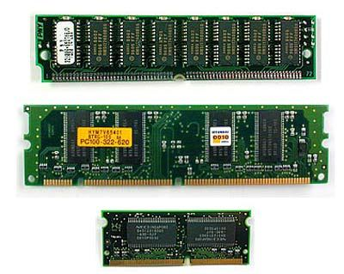
Where does the “data” go?
Internal Memory!
Holds both program instructions and data
Composition
RAM (Random Access Memory)
ROM (Read Only Memory)
External memory
Long term data storage
Disks, Hard drives, USB etc.
Notes:
RAM – volatile. Needs power to work
ROM – non-volatile and permanent data and/or instructions! System on / off

Slide 13
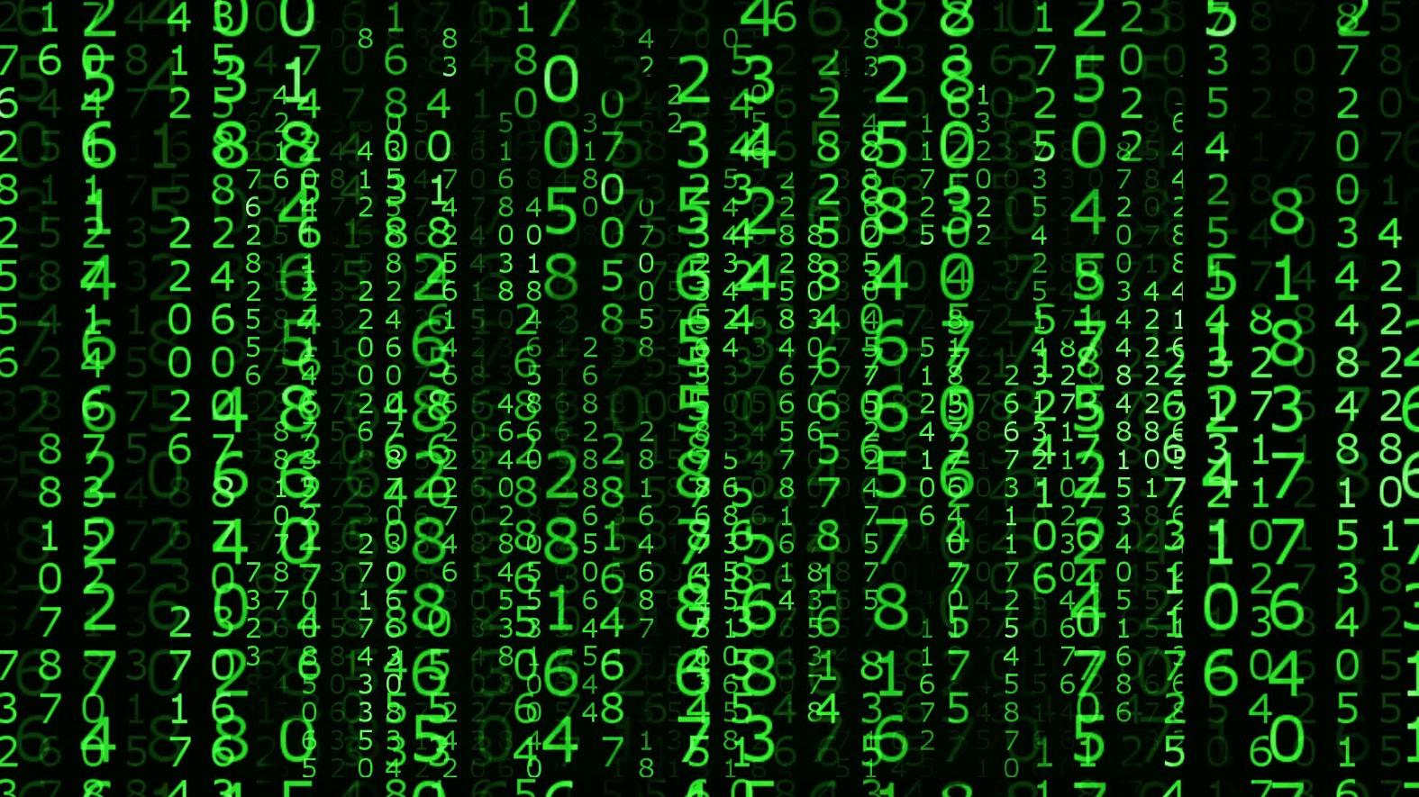
Where do I write the code?
Notes:
What does coding like?

Slide 14
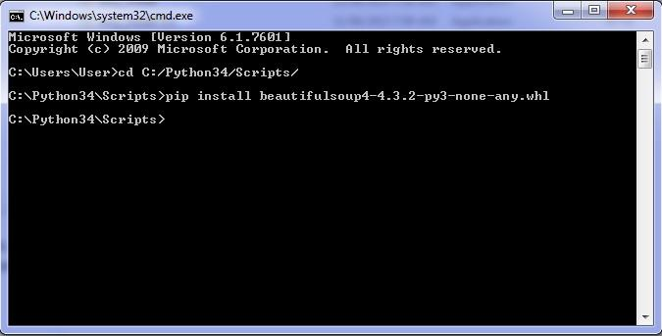
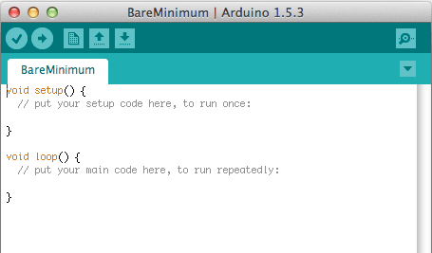
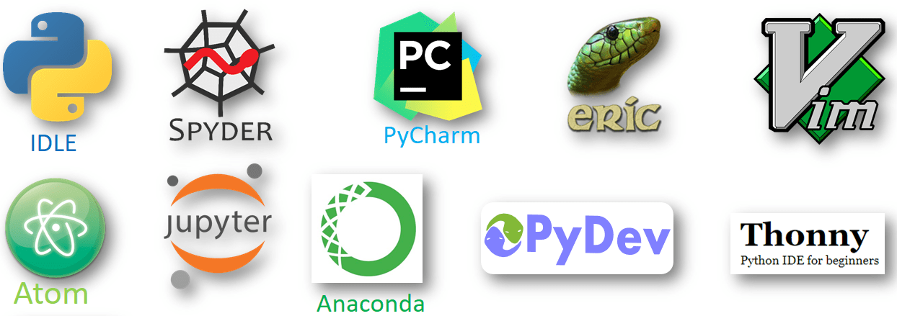
Where do I write the code?
Command Line Prompt (CMD)
Quick
Package Installation, activation etc.
Not beginner friendly
IDE – Integrated development environment
User-friendly
Pre-installed packages, examples, etc.
This Photo by Unknown Author is licensed under CC BY-SA
Notes:
Type Cmd in windows. Or cmd button on Mac

Slide 15
Key Takeaways
User input -> via mouse, keyboard, touch screen
System output -> monitor (text or graphics), audio
Running the code = Compiles the code + execute instructions (aka lines of code)
Syntax = programming language-specific words or symbols e.g. (), “ ”, if, String
IDE = platform for writing codes

Slide 16

Coding
THE TECHNICAL IMPLEMENTATION

Slide 17
What IDE we will use today
Google Colab
https://colab.research.google.com/
- Opens a “notebook”
Notes:
Introduce Jupyter notebook. Show them the add sign and how to run.
Ask them to work with you.

Slide 18
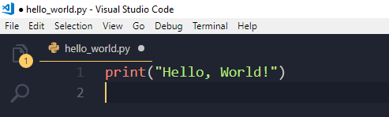
Hello World!
To display custom text or data: print()
Formatting output display
\n – to move the cursor to the next line
\t – to move the cursor by a tab

Slide 19
Can you print this?
Is Pineapple a valid pizza topping?
1) Yes
2) No

Slide 20


Design this!

Slide 21
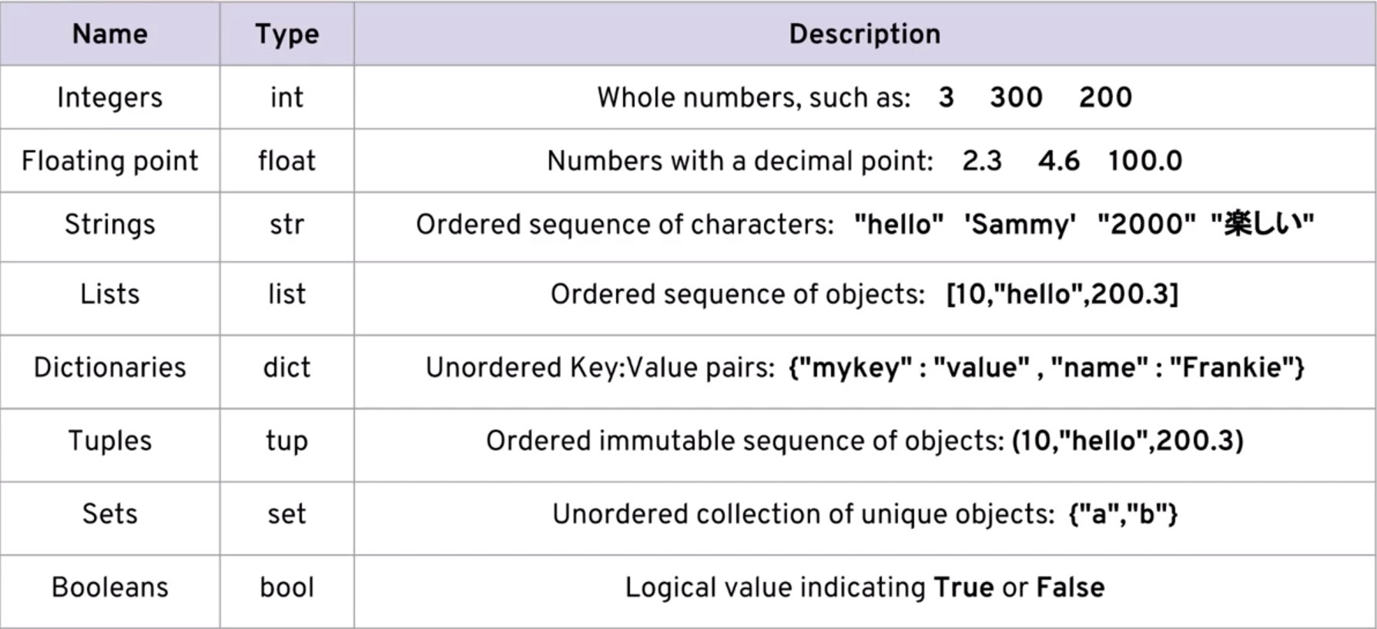
Data types
Notes:
Practice here
x = 10
y = 9.1
z = 'Hello'
#printing the variable types
print("x is of ",type(x))
print("y is of ",type(y))
print("z is of ",type(z))

Slide 22
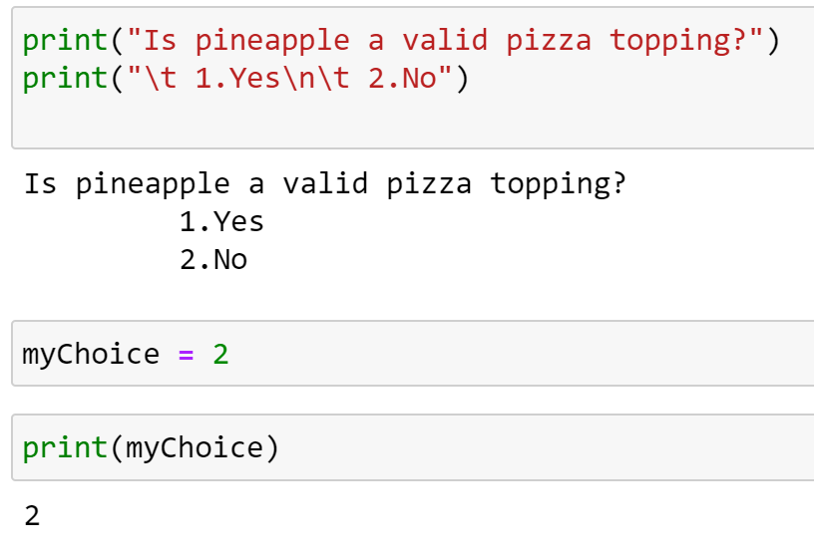
Notes:
Explain the importance of “ ”.

Slide 23
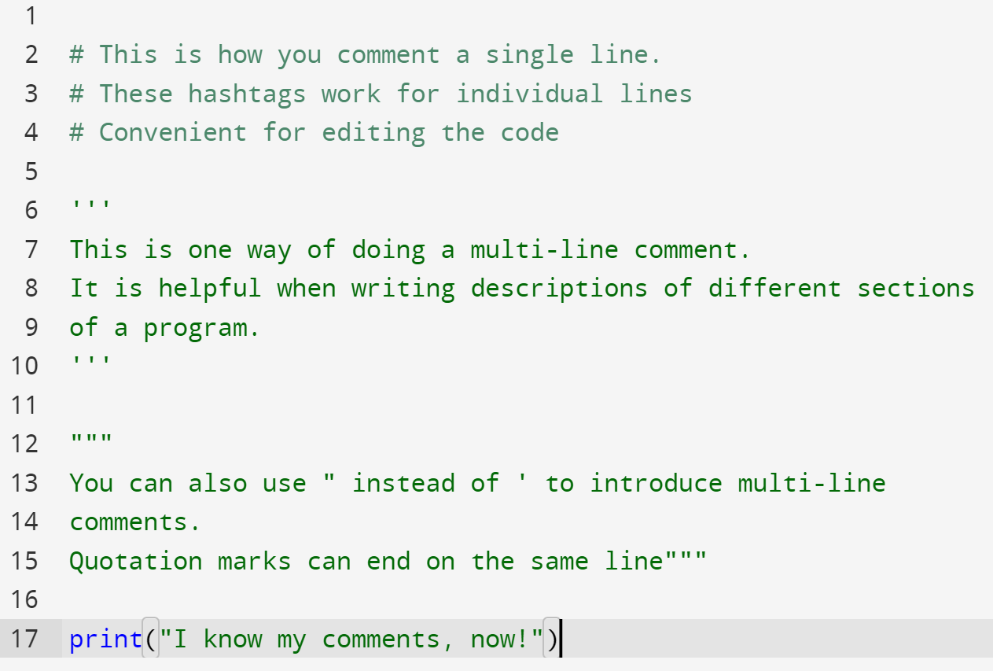
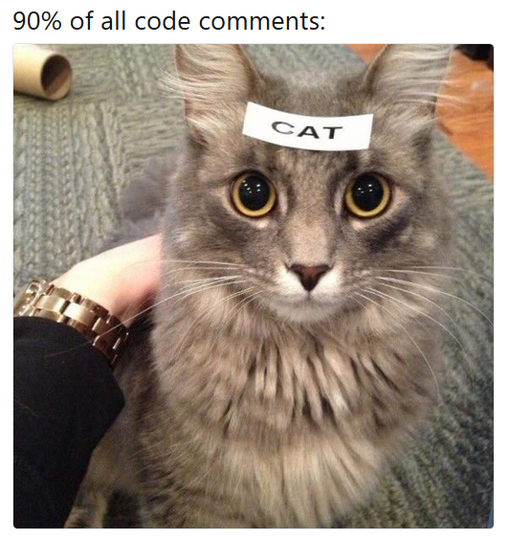
Comments
Meaningful descriptions.
Issues
Constraints
Explanation
Types of comments:
Single Line comments
Multiline comments

Slide 24
Post assessment

Slide 25
Resources
Basic definitions: https://hackr.io/blog/programming-terms-definitions-for-beginners​
Data types with example: https://www.w3schools.com/python/python_datatypes.asp​

Slide 26
Defining Variables
Assignment operator “ = ”
myVar = 7
Lottery_Number = 112567
Naming convention
1. Start with a letter or underscore
2. Case sensitive
3. Numbers are allowed. *
4. Readability and convention
5. Cannot be same as a keyword

Slide 27
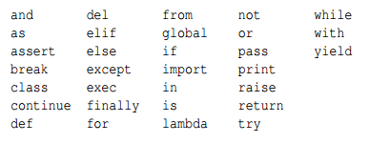
Keywords

Slide 28
Arithmetic
Practice on code.
- Plus (+) , minus (-) , multiply (*) , divide (/)
- increment and decrement
- greater than (>), less than (<), equal (==)
- BDMAS rule
Notes:
Practice here

Slide 29
User Input
Input ()
Input(“Add prompt here”)
Return type = STRING !! – what if we need a number???
number = int(myString)
# taking user input
print("Please enter a number: ")
val = input()
# OR
value = input("Please enter a string:\n")

Slide 30
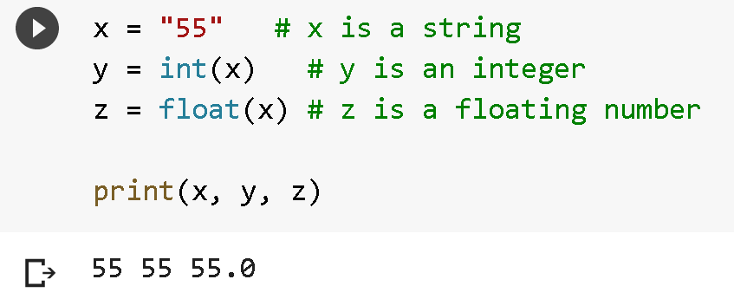
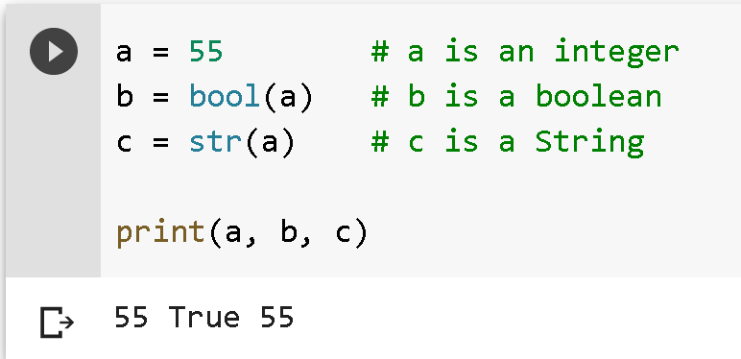
Casting

Slide 31
Problem Solving
LOGICAL THINKING
Notes:
Let’s talk about the term logical thinking first ..

Slide 32

Without Logic
Notes:
Problem: Decipher a message

Slide 33
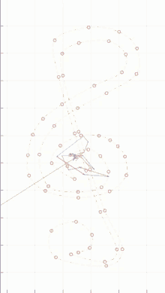
With Logic
LOGIC - a system or set of principles underlying the arrangements of elements in a computer or electronic device so as to perform a specified task.
OR
A system which is deployed to solve a problem!
Notes:
If someone asks: What logic are you using?

Slide 34
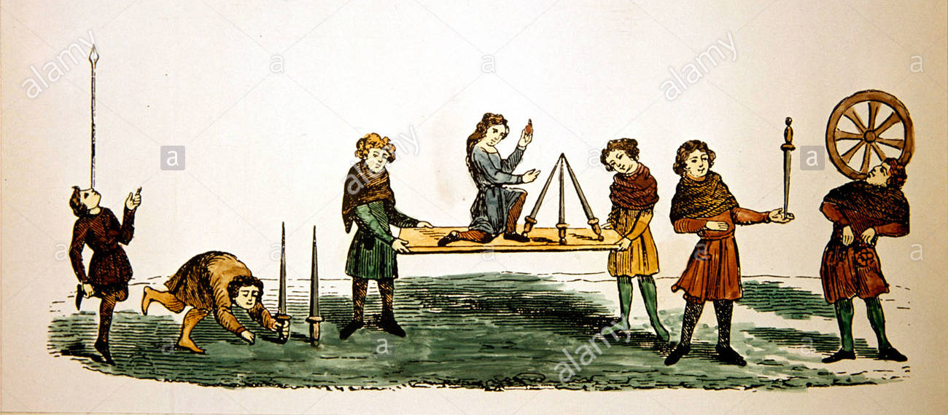
Problem Solving in Engineering
Engineer → Ingeniator → Ingeniare ("to create, devise") → Ingenium ("cleverness")
Understand the problem
1
Solve the problem
2
Notes:
Latin words. Iron Ring- initial batch of rings was made from the beams of the first Quebec Bridge, a bridge that collapsed during construction in 1907 due to poor planning and design by the overseeing engineers.
Engg and Tech companies are not just free food and bean bag chairs - Great deal of ethics and responsibility involved.

Slide 35


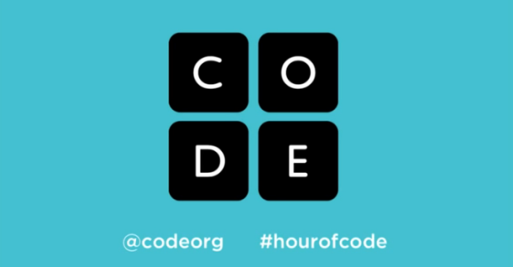
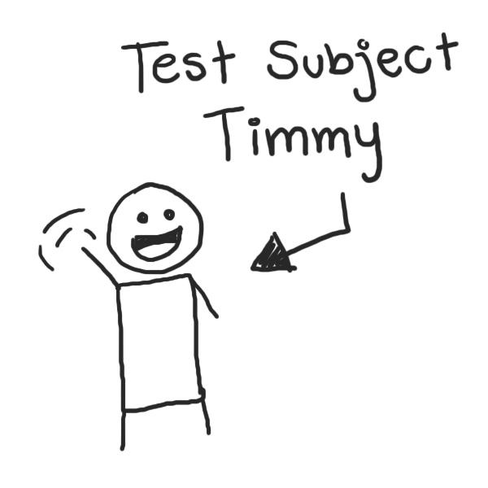
SPECIFICATIONS
Identify needs, functions, results
Problem Solving Approach
In Engineering/ Programming.
DESIGN
Algorithm: pseudocode, flowchart etc.
IMPLEMENTATION
Language: Java, C++, R, etc.
Platform: Mac, Windows, Android
TESTING
Re-testing
Try multiple scenario
Notes:
Specifications – most important – dictate all the other steps.
Example problem to demo: Library book count
1st two steps – understand the problem. Last 2 steps – solve the problem.

Slide 36

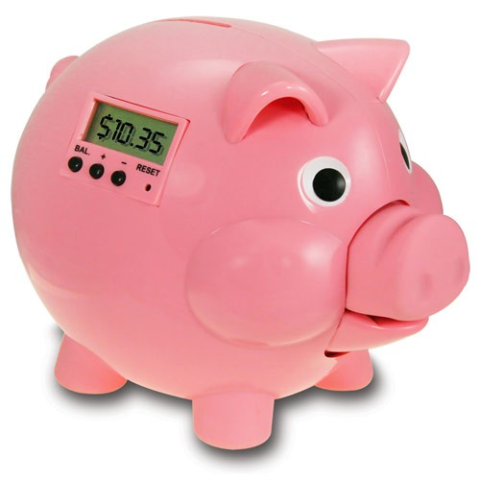
Digital Piggy Bank 1.0
Outline the specifications and design considerations
Notes:
Let’s try another problem but this time we do it in groups. Hopefully more ideas generated as a group!

Slide 37
Design
Input
Money added
Output
Text displaying the total sum of money
Algorithm
Ask user to enter the money
New money is entered
New money is added to existing money
Display the total sum of money

Slide 38
Implementation & Testing
#Ask user to enter the money
#New money is entered
#New money is added to existing money (30$$)
#Display the total sum of money

Slide 39
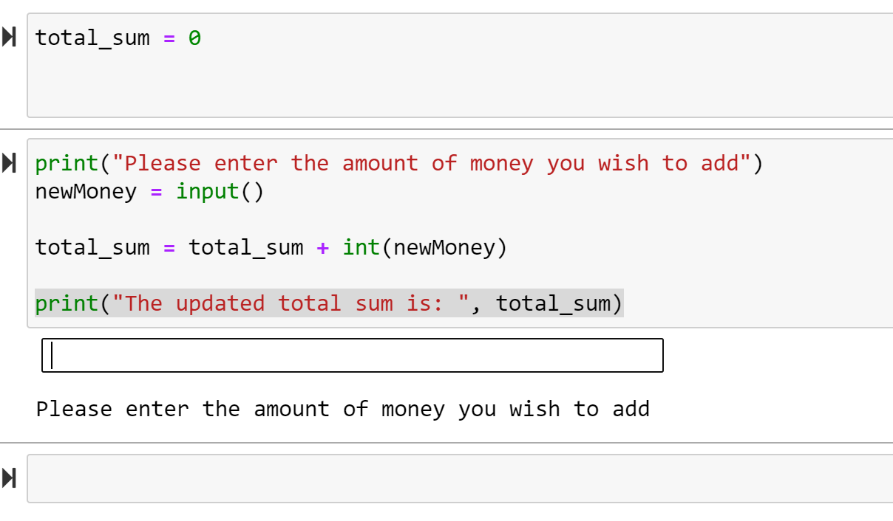
Implementation

Slide 40
